Slide 1


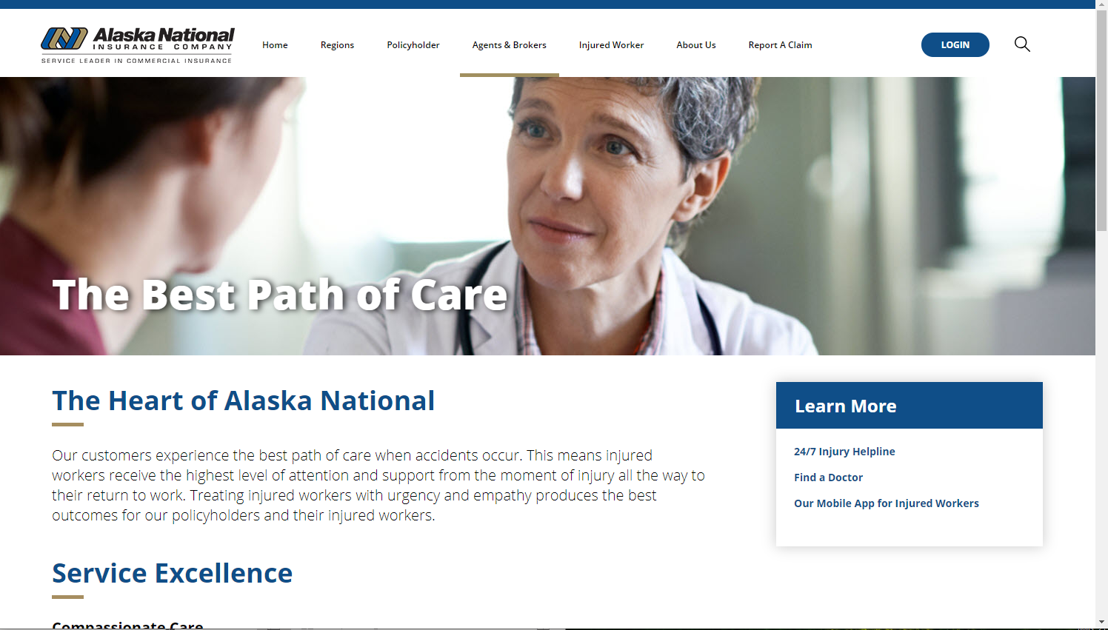


Alaska National Insurance - Sitefinity Upgrade & Redesign
Who They Are
Alaska National Insurance, through its subsidiaries, offers commercial insurance products and services. The company was founded in 1979 and is headquartered in Anchorage, Alaska.
What We Did
Affirma provided Alaska National with recommendations for technical, functional and design improvements across their external site and internal portal.
We then implemented the below and have worked with Alaska National on other projects for the last 5 years.
Sitefinity version upgrade, Fixing bugs or redirect issues, Improved deployment, pipeline and testing processes, Accessibility & compliance
Provided a “Refresh” that modernized the site, without losing the look and feel
Responsive Design, Improved UX through heuristic evaluations
Affirma acts as an extension of AN’s development team, and interfaces with their marketing, development, and IT groups through a single Affirma Project Team (Dev Lead, PM, CEM)
We help their team with troubleshooting and training
Support in content edits, and creation of new visual assets
Results
Refreshed site look and feel
Business and technical users are very happy with our support and have continued to work with us to drive value on both the site and portal.

